Slide 1
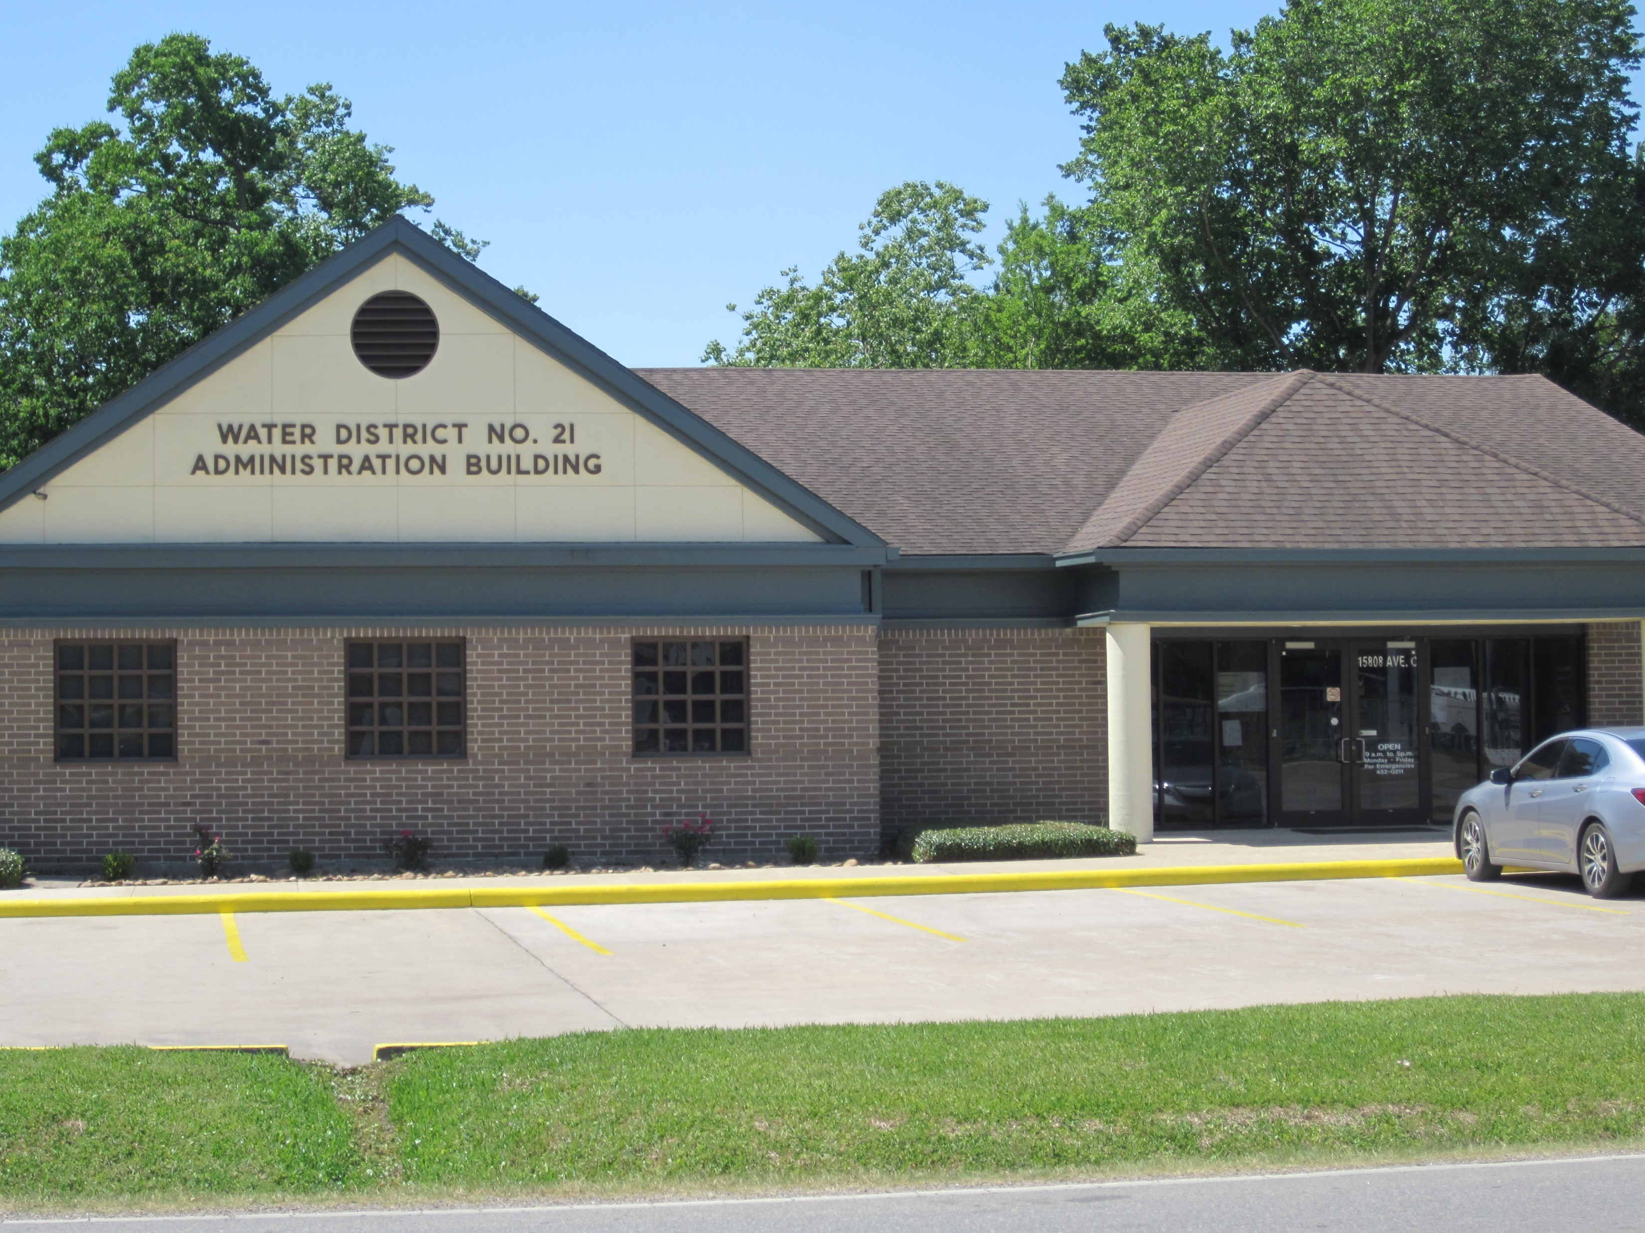
HARRIS COUNTY WATER DISTRICT 21 OFFICE BUILDING IMPROVENT INTERIOR/EXTERIOR TANKS REHAB, BASIN TREATED WASTE REMOVAL AND DIFFUSER REPLACE

Slide 2
PROVIDING MAINTENANCE SERVICES AND FACILITY UPKEEP
Basin Treated Waste Removal, Cleaning and Diffuser replacement
Installation of US Flag Poles
Safety Showers
Painting and Repairs of Industrial Water/Waste Water Tanks
Painting Harris County Water District Office Buildings
Interior Improvements, Carpet, Wood Ceramic Flooring
Front Counter Custom Cabinets and Granite Counter Tops
Pipe, support, bollards, Welding and Fabrication
Plumbing/Electrical
Parking Lot Stripe
Landscape and Tree Removal

Slide 3
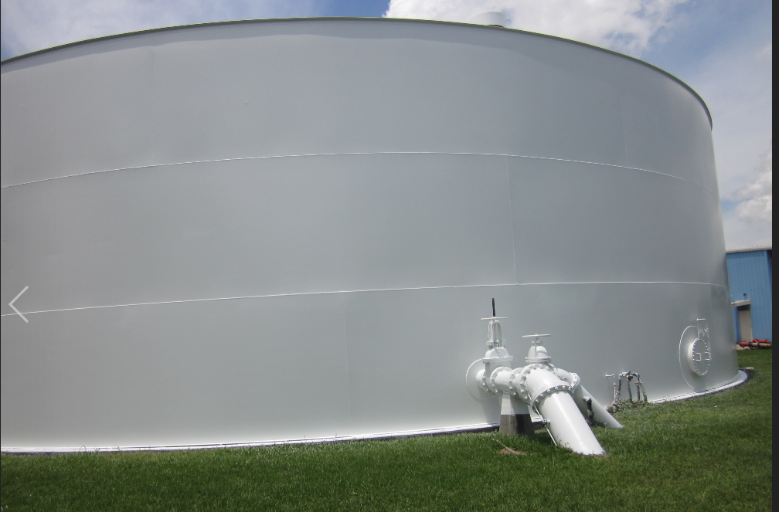
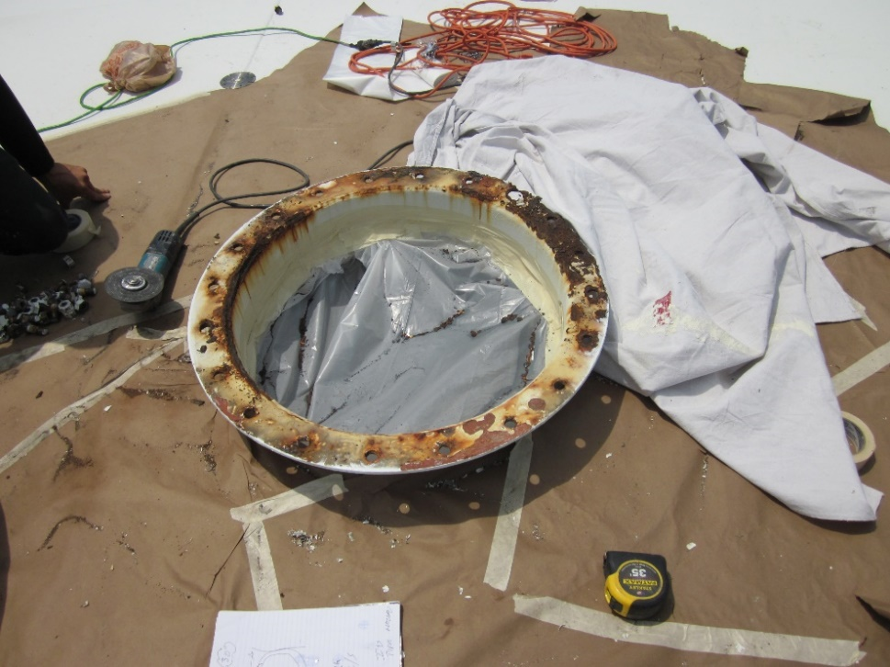
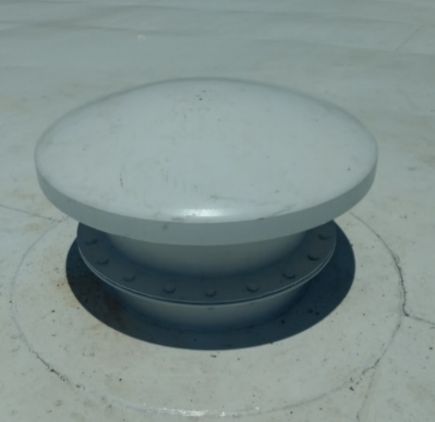
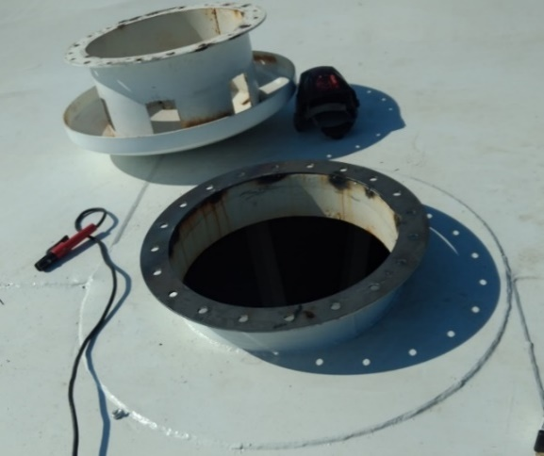
PROVIDING MAINTENANCE SERVICES AND FACILITY UPKEEP TANK WELD REPAIRS

Slide 4
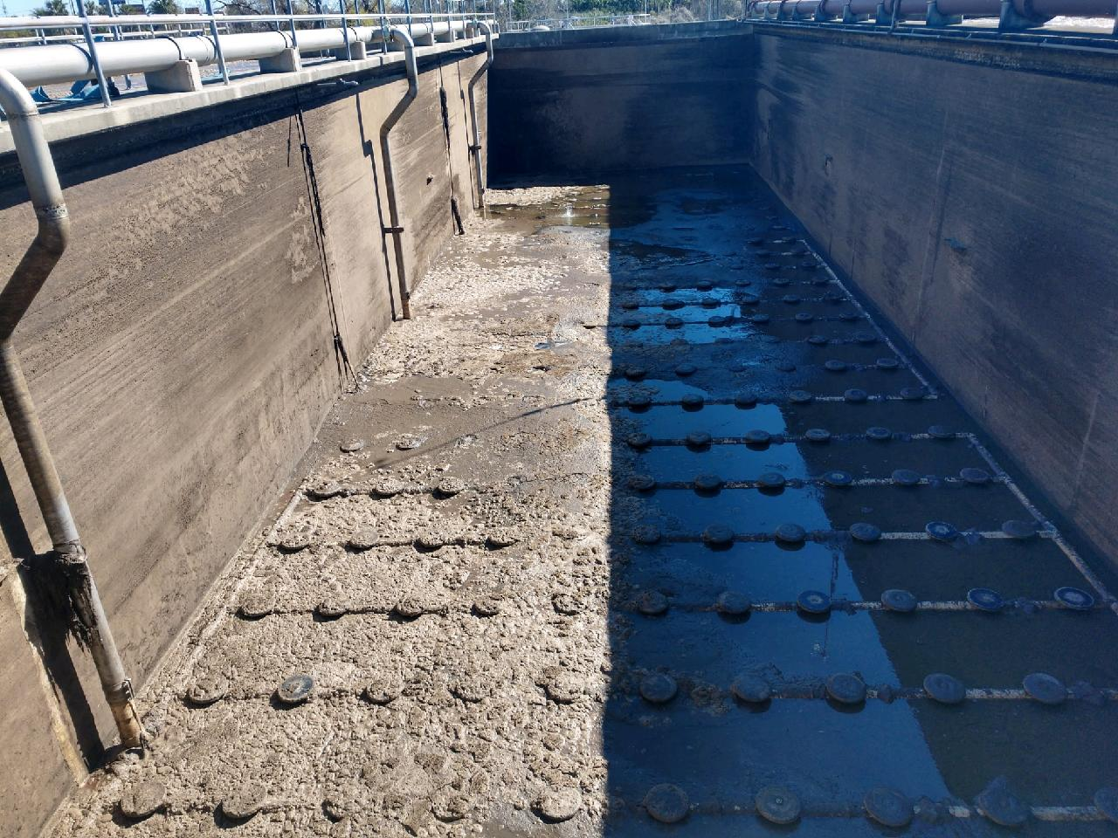
PROVIDING MAINTENANCE SERVICES AND FACILITY UPKEEP BASIN TREATED WASTE REMOVAL AND DIFFUSER REPLACE

